Slide 1
Inequality notation to express error
Estimation and rounding

Slide 2
how to use Oak lessons

Slide 3
I can calculate possible errors expressed using inequality notation a ≤ x < b.

Slide 4
An error interval for a number x shows the range of possible values of x.
It is written as an inequality a ≤ x < b .

Slide 5
A range of values where every value in the range estimates to the given value.
Example
Rounding an integer is 300 to the nearest 100, so the range of values for the unrounded number is 250 to 349.9
Example
Rounding 23 to 2 s.f., so the range of values for the unrounded number is 22.5 to 23.49

Slide 6

Inequality notation to express error
Range of values on a number line
Error intervals

Slide 7
Range of values on a number line
We use decimals and integers in everyday life. Sometimes rounded numbers are presented to us and it is important we are able to calculate the largest and smallest unrounded numbers.

Slide 8
Range of values on a number line
For example, what is the largest and smallest integer when 430 is rounded to the nearest 10?
A number line can help.
425
435
420
430
440
435 rounded to the nearest 10 gives 440
Put 430 in the centre.
and − 10 (10 is the degree of accuracy)
What do the middle values represent?
425 is the smallest integer when rounded to the nearest 10 gives 430
434 is the largest integer when rounded to the nearest 10 gives 430

Slide 9
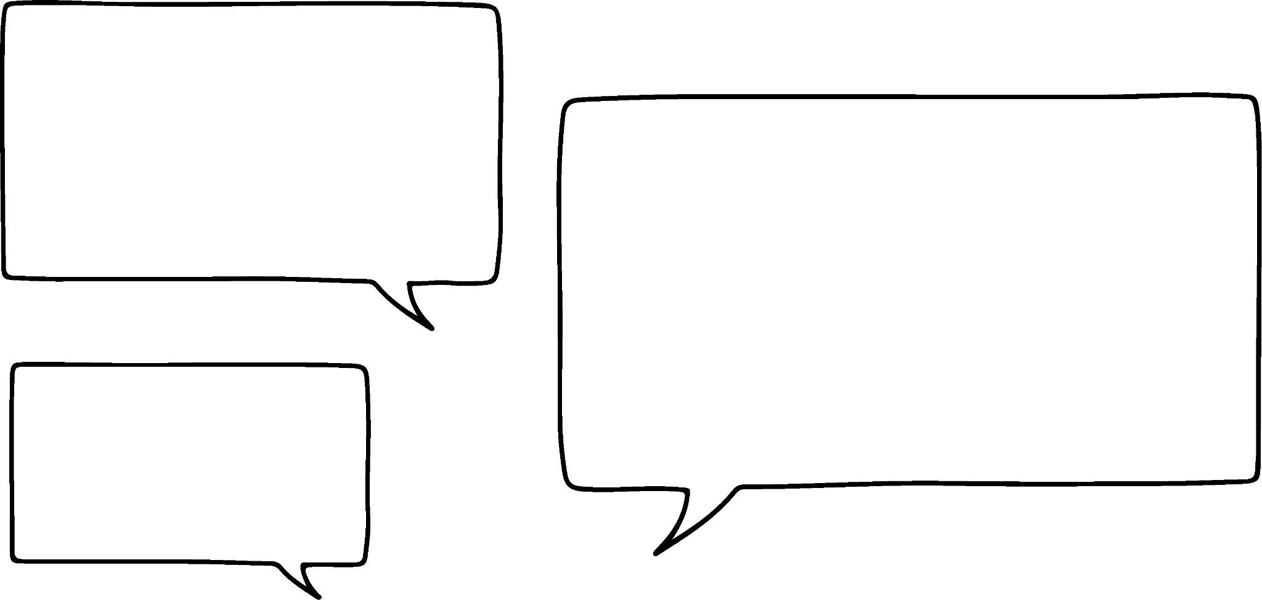


Range of values on a number line
Are the largest and smallest values of an unrounded number always an integer?
Let’s find out! If 5 has been rounded to the nearest integer, what are the largest and smallest unrounded values?
Jacob
Sofia
4
5
6

Slide 10
Range of values on a number line
Hmmm, let’s zoom in to see if we can find the largest number when rounded gives 5
I’ve labelled the halfway points on the number line
Jacob
Sofia
4.5
5.5
4
5
6

Slide 11

Range of values on a number line
Hmmm, let’s zoom in to see if we can find the largest number when rounded gives 5
Jacob
Sofia
5.5
4
5
6

Slide 12
Range of values on a number line
There is a larger number than 5.4 when rounded gives 5. Let’s zoom in again.
Is the largest number when rounded to 5 to the nearest integer 5.4?
Jacob
Sofia
5
5.1
5.2
5.3
5.4
5.5

Slide 13
Range of values on a number line
There is a larger number than 5.4 when rounded gives 5. Let’s zoom in again.
Jacob
Sofia
5
5.1
5.2
5.3
5.4
5.5

Slide 14
Range of values on a number line
Is the largest number when rounded to 5 to the nearest integer 5.49?
There is a larger number than 5.49 when rounded gives 5. Let’s zoom in again.
Jacob
Sofia
5.4
5.42
5.44
5.46
5.48
5.5

Slide 15
Range of values on a number line
There is a larger number than 5.49 when rounded gives 5. Let’s zoom in again.
Jacob
Sofia
5.4
5.42
5.44
5.46
5.48
5.5

Slide 16
Range of values on a number line
So in between 5.49 and 5.5, I have these intervals …
But there is still a larger number than 5.499 when rounded gives 5
Jacob
Sofia
5.49
5.492
5.494
5.496
5.498
5.5

Slide 17
Range of values on a number line
Let’s zoom in again.
Jacob
Sofia
5.49
5.492
5.494
5.496
5.498
5.5

Slide 18
Range of values on a number line
There is a larger number than 5.4999 when rounded gives 5
Is it 5.4999?
Jacob
Sofia
5.499
5.4992
5.4994
5.4996
5.4998
5.5

Slide 19
Range of values on a number line
So the range is from 4.5 to 5.49
Jacob
Sofia
4.5
5.5
4
5
6

Slide 20
Range of values on a number line
We could zoom in an infinite number of times to see the largest unrounded number.
Recognising we are not using 5.5 but a number which is infinitely smaller than this gives 5.49 as the largest number. Thus the range of values for the unrounded number is 4.5 to 5.49
4.5
5.5
4
5
6

Slide 21
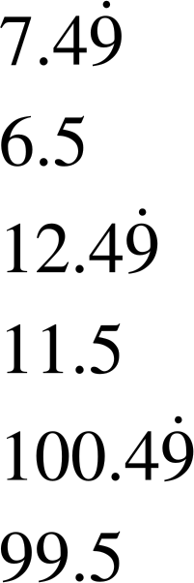
Range of values on a number line
Identify the range of unrounded values when:
a) 7 has been rounded to the nearest integer.
b) 12 has been rounded to the nearest integer.
c) 100 has been rounded to the nearest integer.
Largest:
Smallest:
6
6.5
7
7.5
8
Largest:
Smallest:
11
11.5
12
12.5
13
Largest:
Smallest:
99
99.5
100
100.5
101

Slide 22
Range of values on a number line
When trying to work out the range of unrounded numbers with units, it is important to focus on which units are given and compare to the degree of accuracy.
For example,
2.13 m
Which digit represents the integer cm?
The 3 represents the integer cm.
 |  | kilo |  |  | metres |  | centi | milli
.
2
1
3

Slide 23
Range of values on a number line
When trying to work out the largest and smallest unrounded numbers with units, it is important to focus on which units are given and compare to the degree of accuracy.
For example,
2.13 m
2.13 m has been rounded to the nearest cm. What are the largest and smallest unrounded values?
212
212.5
213
213.5
214
Therefore we know = 213 cm
Smallest unrounded number : 212.5 cm
Largest unrounded number : 213.49 cm

Slide 24
Range of values on a number line
5.126 km has been rounded to the nearest m. What is the range of unrounded values?
21.3 cm has been rounded to the nearest mm. What is the range of unrounded values?
kilo |  |  | metres |  | centi | milli
5 | 1 | 2 | 6
Smallest: 5125.5 m
Largest: 5126.49 m
5125
5125.5
5126
5126.5
5127
kilo |  |  | metres |  | centi | milli
 |  |  |  | 2 | 1 | 3
Smallest: 212.5 mm
Largest: 213.49 mm
212
212.5
213
213.5
214

Slide 25
Range of values on a number line
Identify the range of unrounded values when:
a) 34 has been rounded to the nearest integer.
b) 63 has been rounded to the nearest integer.
c) 1 has been rounded to the nearest integer.

Slide 26
Range of values on a number line
2) Identify the range of unrounded values when:
a) 6 has been rounded to 1 s.f.
b) 56 has been rounded to the 2 s.f.
c) 1000 has been rounded to 4 s.f.

Slide 27
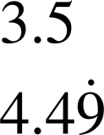
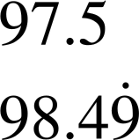
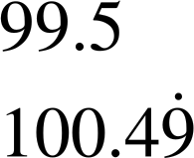
Range of values on a number line
3) Work out the question given the following:
a) 4 has been rounded to 1 s.f.
b) 98 has been rounded to the 2 s.f.
c) 100 has been rounded to the nearest integer
Smallest:
Largest:
Smallest:
Largest:
Smallest:
Largest:

Slide 28
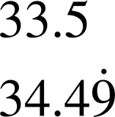
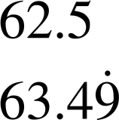
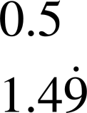
Range of values on a number line
Identify the range of unrounded values when:
a) 34 has been rounded to the nearest integer.
b) 63 has been rounded to the nearest integer.
c) 1 has been rounded to the nearest integer.
Smallest:
Largest:
Smallest:
Largest:
Smallest:
Largest:

Slide 29
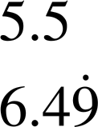
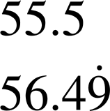
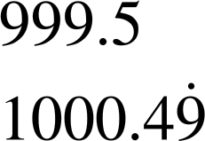
Range of values on a number line
2) Identify the range of unrounded values when:
a) 6 has been rounded to 1 s.f.
b) 56 has been rounded to the 2 s.f.
c) 1000 has been rounded to 4 s.f.
Smallest:
Largest:
Smallest:
Largest:
Smallest:
Largest:

Slide 30
Range of values on a number line
3) Work out the question given the following:
a) 4 has been rounded to 1 s.f.
b) 98 has been rounded to the 2 s.f.
c) 100 has been rounded to the nearest integer
Smallest:
Largest:
Smallest:
Largest:
Smallest:
Largest:

Slide 31
Inequality notation to express error
Range of values on a number line
Error intervals

Slide 32
Error intervals
Notation in mathematics is very important.
We use symbols and notation because:
they are easier to read and understand
they are concise and take up less space
they can be used to represent complex concepts
it allows mathematical ideas to be communicated more effectively than words

Slide 33
Error intervals
This can also be said when trying to find the range of unrounded values of a number. We use an error interval.
An error interval for a number x shows the range of possible values of x. It is written as an inequality a ≤ x < b
The notation we use allows us to concisely identify unrounded values of a number.

Slide 34

Error intervals
Well, I know the unrounded numbers have to be between this highlighted line.
You want the range of values to include 4.5 and not include 5.5
Jacob
Andeep
4.5
5.5
4
5
6
5 has been rounded to the nearest integer.
What is the range of values of the unrounded numbers?

Slide 35
Error intervals
The range of values of the unrounded numbers is given as
4.5 is included
4.5 ≤ x < 5.5
5.5 is not included
Jacob
Andeep
4.5
5.5
4
5
6
5 has been rounded to the nearest integer.
What is the range of values of the unrounded numbers?

Slide 36


Error intervals
Here is a number line used to help identify the error interval. Whose answer is correct? Explain.
Work out the error interval given 43 has been rounded to the nearest integer.
42.5
43.5
42
43
44
It is
It is
It is
42.5 ≤ x > 43.5
42.5 ≤ x ≤ 43.5
42.5 ≤ x < 43.5
Sofia
Sam
Izzy

Slide 37
Error intervals
Here is a number line used to help identify the error interval. Whose answer is correct? Explain.
Work out the error interval given 43 has been rounded to the nearest integer.
42.5
43.5
42
43
44
It is
This is incorrect because Sam is including 42.5 and 43.5 in the range of values.
43.5 would round to 44
42.5 ≤ x ≤ 43.5
Sam

Slide 38
Error intervals
Here is a number line used to help identify the error interval. Whose answer is correct? Explain.
Work out the error interval given 43 has been rounded to the nearest integer.
42.5
43.5
42
43
44
It is
42.5 ≤ x > 43.5
Sofia
Sofia is saying the range of values are greater than or equal to 42.5 and greater than 43.5

Slide 39
Error intervals
Here is a number line used to help identify the error interval. Whose answer is correct? Explain.
Work out the error interval given 43 has been rounded to the nearest integer.
42.5
43.5
42
43
44
It is
42.5 ≤ x < 43.5
Izzy has used the correct notation.
Izzy

Slide 40
Error intervals
Here is a number line used to help identify the error interval. Whose answer is correct? Explain.
Work out the error interval given 43 has been rounded to the nearest integer.
42.5
43.5
42
43
44
It is
42.5 ≤ x < 43.5
Izzy has used the correct notation.
Izzy

Slide 41
Error intervals
Any number that has been given to a degree of accuracy has an error interval. This is because of the rounding that has taken place.
It is important to recognise what degree of accuracy is used and then the error interval can be used. A number line can help.

Slide 42
Error intervals
Andeep and Jacob have drawn these number lines to help identify the error interval. Can you identify the error interval?
a) 4.8 rounded to 1 d.p.
b) 1.3 rounded to 2 s.f.
c) 3.42 rounded to 3 s.f.
4.75
4.85
4.7
4.8
4.9
4.75 ≤ x < 4.85
1.25
1.35
1.2
1.3
1.4
1.25 ≤ x < 1.35
3.415
3.425
3.41
3.42
3.43
3.415 ≤ x < 3.425

Slide 43
Error intervals
Given the number lines, identify the error interval.
a) 2 rounded to 1 s.f.
b) 33 rounded to 2 s.f.
c) 10 rounded to 2 s.f.
1
1.5
2
2.5
3
32.5
33.5
32
33
34
9.5
10.5
9
10
11

Slide 44
Error intervals
2) Identify the error interval of the following:
a) 482 is rounded to the nearest whole number.
b) 65 is rounded to the 2 s.f.
c) 7.2 is rounded to 1 d.p.
d) 4.54 is rounded to 2 d.p.

Slide 45
Error intervals
3) Pair up the question with the correct error interval.
3 is rounded to 1 s.f.
3.15 ≤ x < 3.25
3.3 is rounded to 1 d.p.
3.245 ≤ x < 3.255
3.2 is rounded to 2 s.f.
2.5 ≤ x < 3.5
3.25 is rounded to 2 d.p.
3.25 ≤ x < 3.35

Slide 46
Error intervals
Given the number lines, identify the error interval.
a) 2 rounded to 1 s.f.
b) 33 rounded to 2 s.f.
c) 10 rounded to 2 s.f.
1
1.5
2
2.5
3
1.5 ≤ x < 2.5
32.5
33.5
32
33
34
32.5 ≤ x < 33.5
9.5
10.5
9
10
11
9.5 ≤ x < 10.5

Slide 47
Error intervals
2) Identify the error interval of the following:
a) 482 is rounded to the nearest whole number.
b) 65 is rounded to the 2 s.f.
c) 7.2 is rounded to 1 d.p.
d) 4.54 is rounded to 2 d.p.
481.5 ≤ x < 482.5
64.5 ≤ x < 65.5
7.15 ≤ x < 7.25
4.535 ≤ x < 4.545

Slide 48
Error intervals
3) Pair up the question with the correct error interval.
3 is rounded to 1 s.f.
3.15 ≤ x < 3.25
3.3 is rounded to 1 d.p.
3.245 ≤ x < 3.255
3.2 is rounded to 2 s.f.
2.5 ≤ x < 3.5
3.25 is rounded to 2 d.p.
3.25 ≤ x < 3.35

Slide 49
Inequality notation to express error
An error interval for a number x shows the range of possible values of x. It is written as an inequality a ≤ x < b.
Any number than has been given to a degree of accuracy has an error interval. This is because of the rounding that has taken place.
It is important to recognise what degree of accuracy is used and then the error interval can be used. A number line can help.

Slide 50

© Oak National Academy 2024.
Produced in partnership with Mathematics in Education and Industry.
Licensed on the Open Government Licence v3.0, except where otherwise stated. See Oak terms and conditions.

